Slide 1
Utilizing Random Matrix Theory for Solving ill-posed Inverse Problems
Amartansh Dubey, Samruddhi Deshmukh, Nilesh Kumar Jha
Electronic and Computer Engineering,
Hong Kong University of Science and Technology
CSIC 5011 Final Project Presentation

Slide 2
Presentation Outline
Problem Statement and Motivation
Problem Formulation
Establishing Connection to Random Matrix Theory (RMT)
Proposed methods based on RMT
Marcenko-Pastur law (MP law) based method
Shrinkage Transformations
Results and Interpretations
Summary

Slide 3
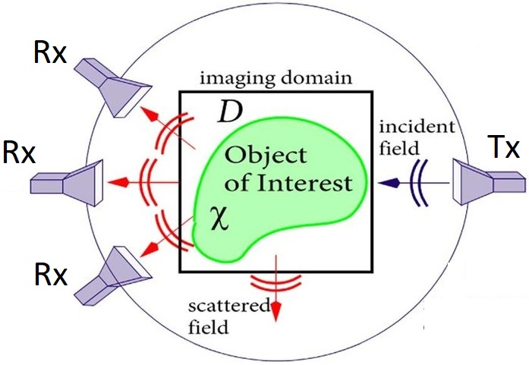
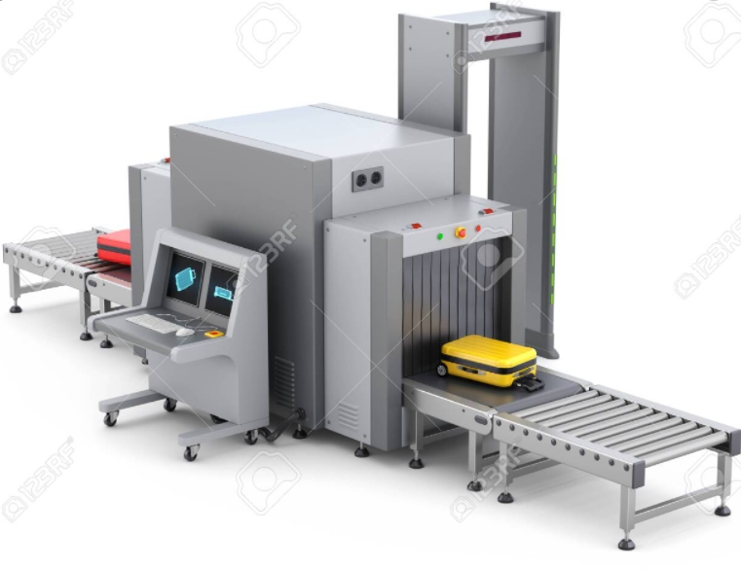
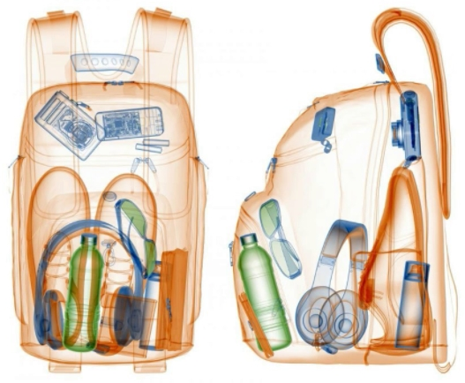
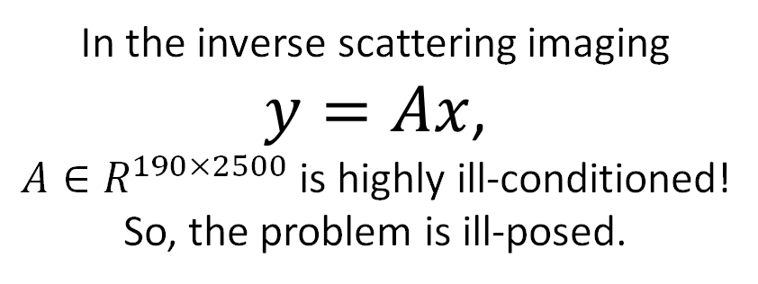
ill-posed Inverse Problems
Well-posed/ill-posed:
Existence
Uniqueness
Stability
Approaches for ill posed problems:
Objective Function approaches
Least squares
Priors (Regularization, MAP)
Bayesian
Learning approaches
In the inverse scattering imaging
$y=Ax$,
$A∈R^{190×2500}$ is highly ill-conditioned!
So, the problem is ill-posed.

Slide 4
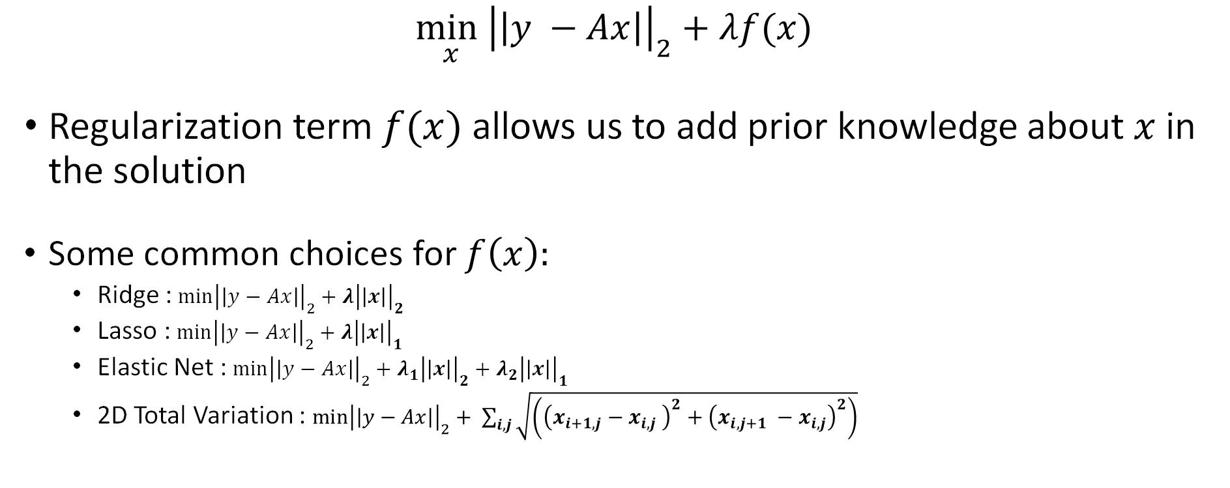
Solve using Regularization
$$\min_{x}{{\left|\left|y −Ax\right|\right|}_{2}+λf(x)}$$
Regularization term $f(x)$ allows us to add prior knowledge about $x$ in the solution
Some common choices for $f\left(x\right):$
Ridge : $\min{{\left|\left|y−Ax\right|\right|}_{2}+λ{\left|\left|x\right|\right|}_{2}}$
Lasso : $\min{{\left|\left|y−Ax\right|\right|}_{2}+λ{\left|\left|x\right|\right|}_{1}}$
Elastic Net : $\min{{\left|\left|y−Ax\right|\right|}_{2}+λ_{1}{\left|\left|x\right|\right|}_{2}+λ_{2}{\left|\left|x\right|\right|}_{1}}$
2D Total Variation : $\min{{\left|\left|y−Ax\right|\right|}_{2}+ \sum_{i,j}{\sqrt{\left({\left(x_{i+1,j}−x_{i,j} \right)}^{2}+{\left(x_{i,j+1} −x_{i,j}\right)}^{2}\right)}}}$

Slide 5
Presentation Outline
Problem Statement and Motivation
Problem Formulation
Establishing Connection to Random Matrix Theory (RMT)
Proposed methods based on RMT
Marcenko-Pastur law (MP law) based method
Shrinkage Transformations
Results and Interpretations
Summary

Slide 6
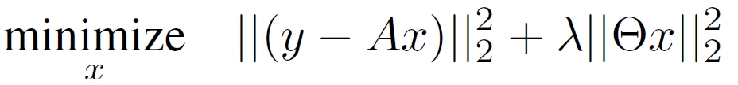
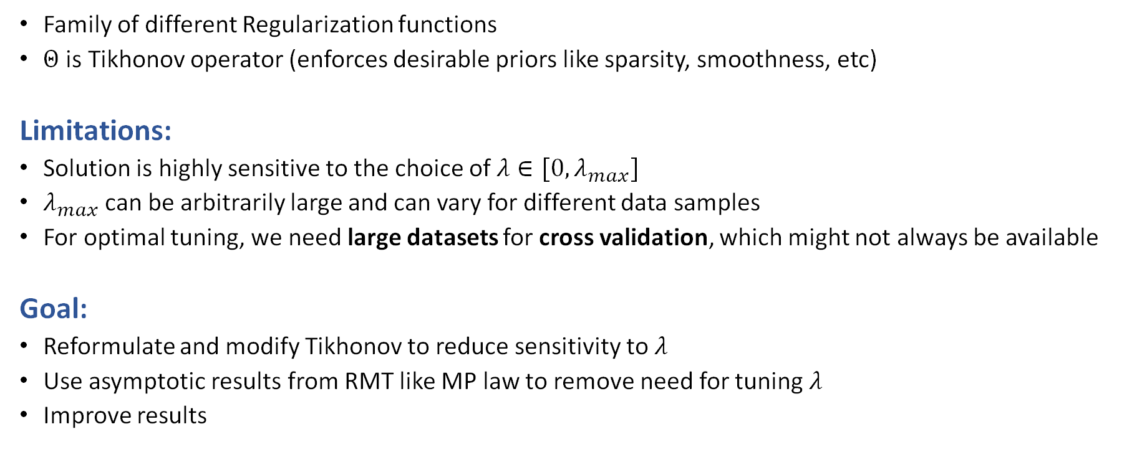
Tikhonov Regularization
Family of different Regularization functions
$Θ$ is Tikhonov operator (enforces desirable priors like sparsity, smoothness, etc)
Limitations:
Solution is highly sensitive to the choice of $λ∈[0, λ_{max}]$
$λ_{max}$ can be arbitrarily large and can vary for different data samples
For optimal tuning, we need large datasets for cross validation, which might not always be available
Goal:
Reformulate and modify Tikhonov to reduce sensitivity to $λ$
Use asymptotic results from RMT like MP law to remove need for tuning $λ$
Improve results

Slide 7
Presentation Outline
Problem Statement and Motivation
Problem Formulation
Establishing Connection to Random Matrix Theory (RMT)
Proposed methods based on RMT
Marcenko-Pastur law (MP law) based method
Shrinkage Transformations
Results and Interpretations
Summary

Slide 8
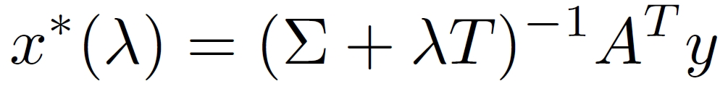
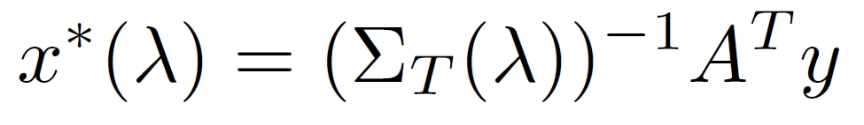
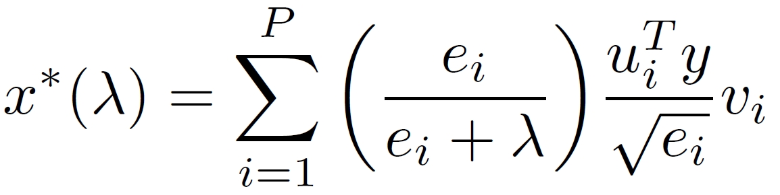
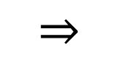
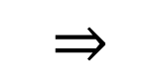

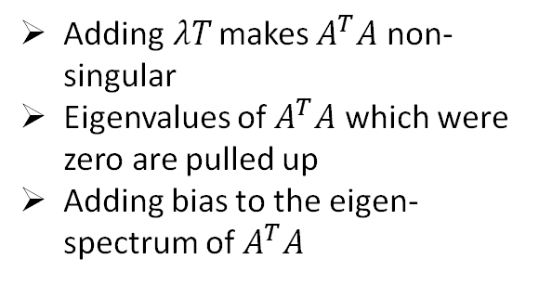
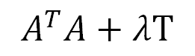
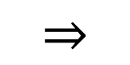
Establishing Connection to RMT
$$A^{T}A+λT$$
Key is to think in terms of Covariance Matrix and Sample Eigenvalues
$$⇒$$
Adding$λT$ makes $A^{T}A$ non-singular
Eigenvalues of $A^{T}A$ which were zero are pulled up
Adding bias to the eigen-spectrum of $A^{T}A$
$$⇒$$
$$⇒$$
So, we can use better tools from RMT to make $A^{T}A$ well conditioned

Slide 9
Presentation Outline
Problem Statement and Motivation
Problem Formulation
Establishing Connection to Random Matrix Theory (RMT)
Proposed methods based on RMT
Marcenko-Pastur law (MP law) based method
Shrinkage Transformations
Results and Interpretations
Summary

Slide 10
Proposed Methods
Proposed Methods
Subspace methods
PCA
Sparse PCA
Robust PCA
Random Matrix Theory
Marchenko-Pastur law (MP law) based method
Shrinkage Transformations
Covered in the Mini-Project

Slide 11
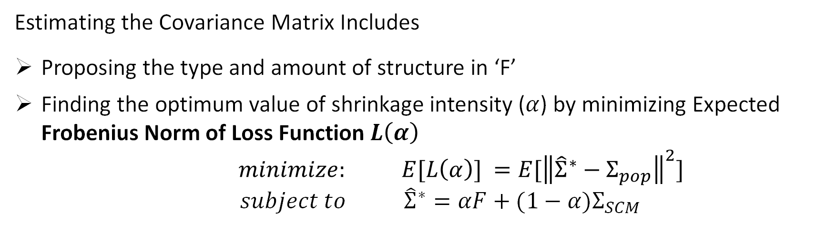
Linear Shrinkage
$${\hat{Σ}}^{∗}=αF+(1−α)Σ_{SCM}$$
Shrinkage Intensity:
Deals with Bias-Variance Tradeoff
Shrinkage Target: Imposes structure (introduces bias)
Sample Covariance Matrix: High variance
Estimating the Covariance Matrix Includes
Proposing the type and amount of structure in ‘F’
Finding the optimum value of shrinkage intensity ($α$) by minimizing Expected Frobenius Norm of Loss Function $L\left(α\right)$
$minimize: E[L\left(α\right)] ={E[\left\|{\hat{Σ}}^{∗}−Σ_{pop}\right\|}^{2}]$
$$subject to { \hat{Σ}}^{∗}=αF+(1−α)Σ_{SCM}$$

Slide 12
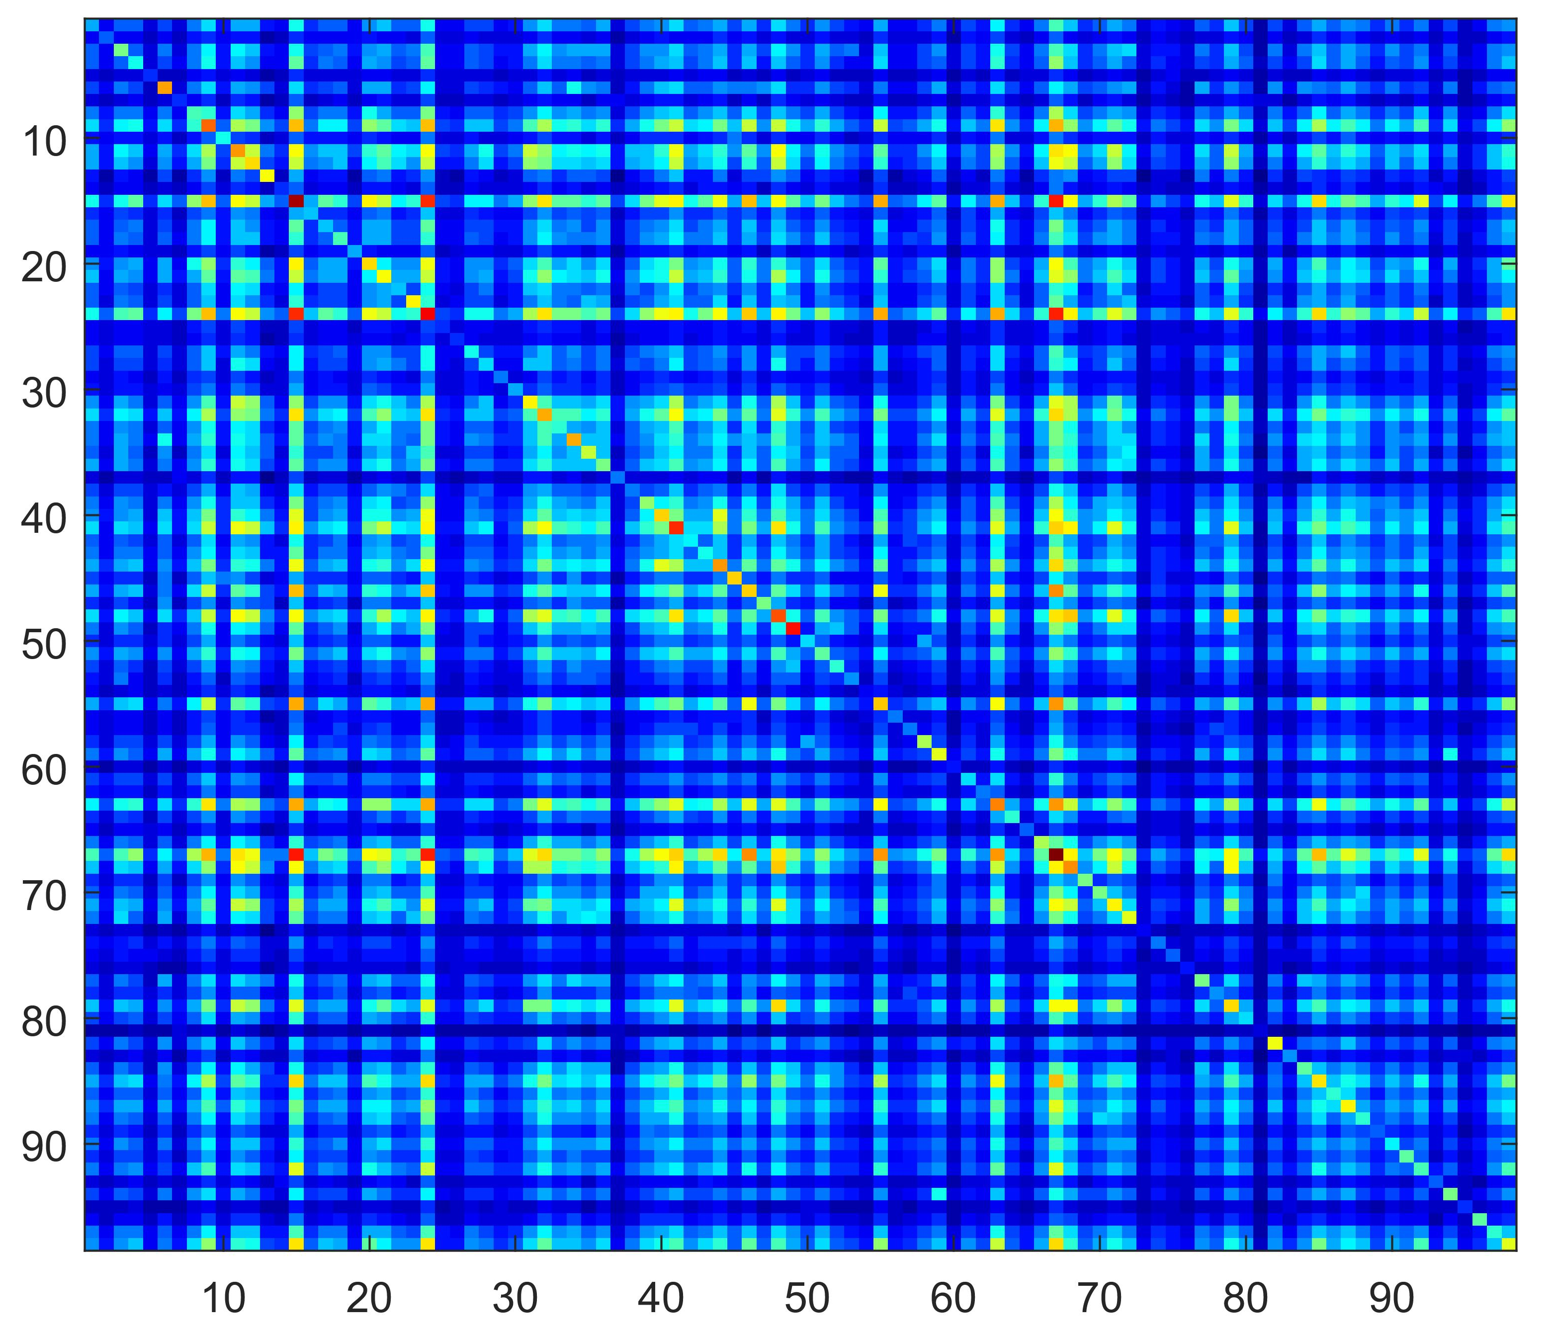
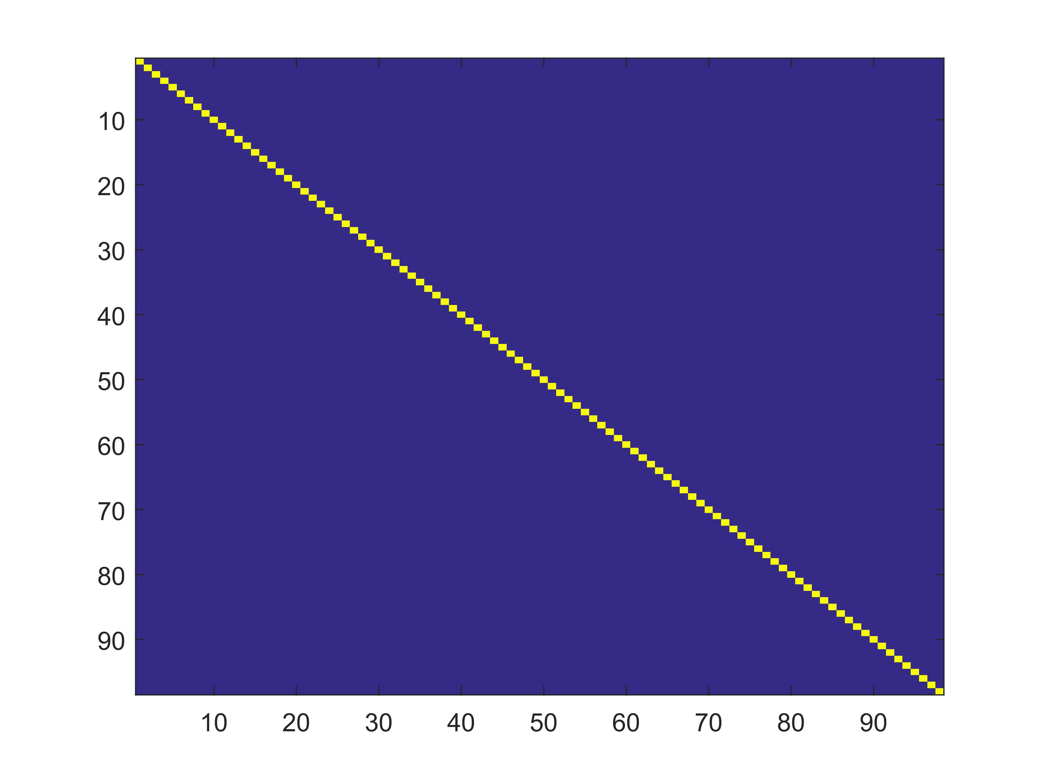
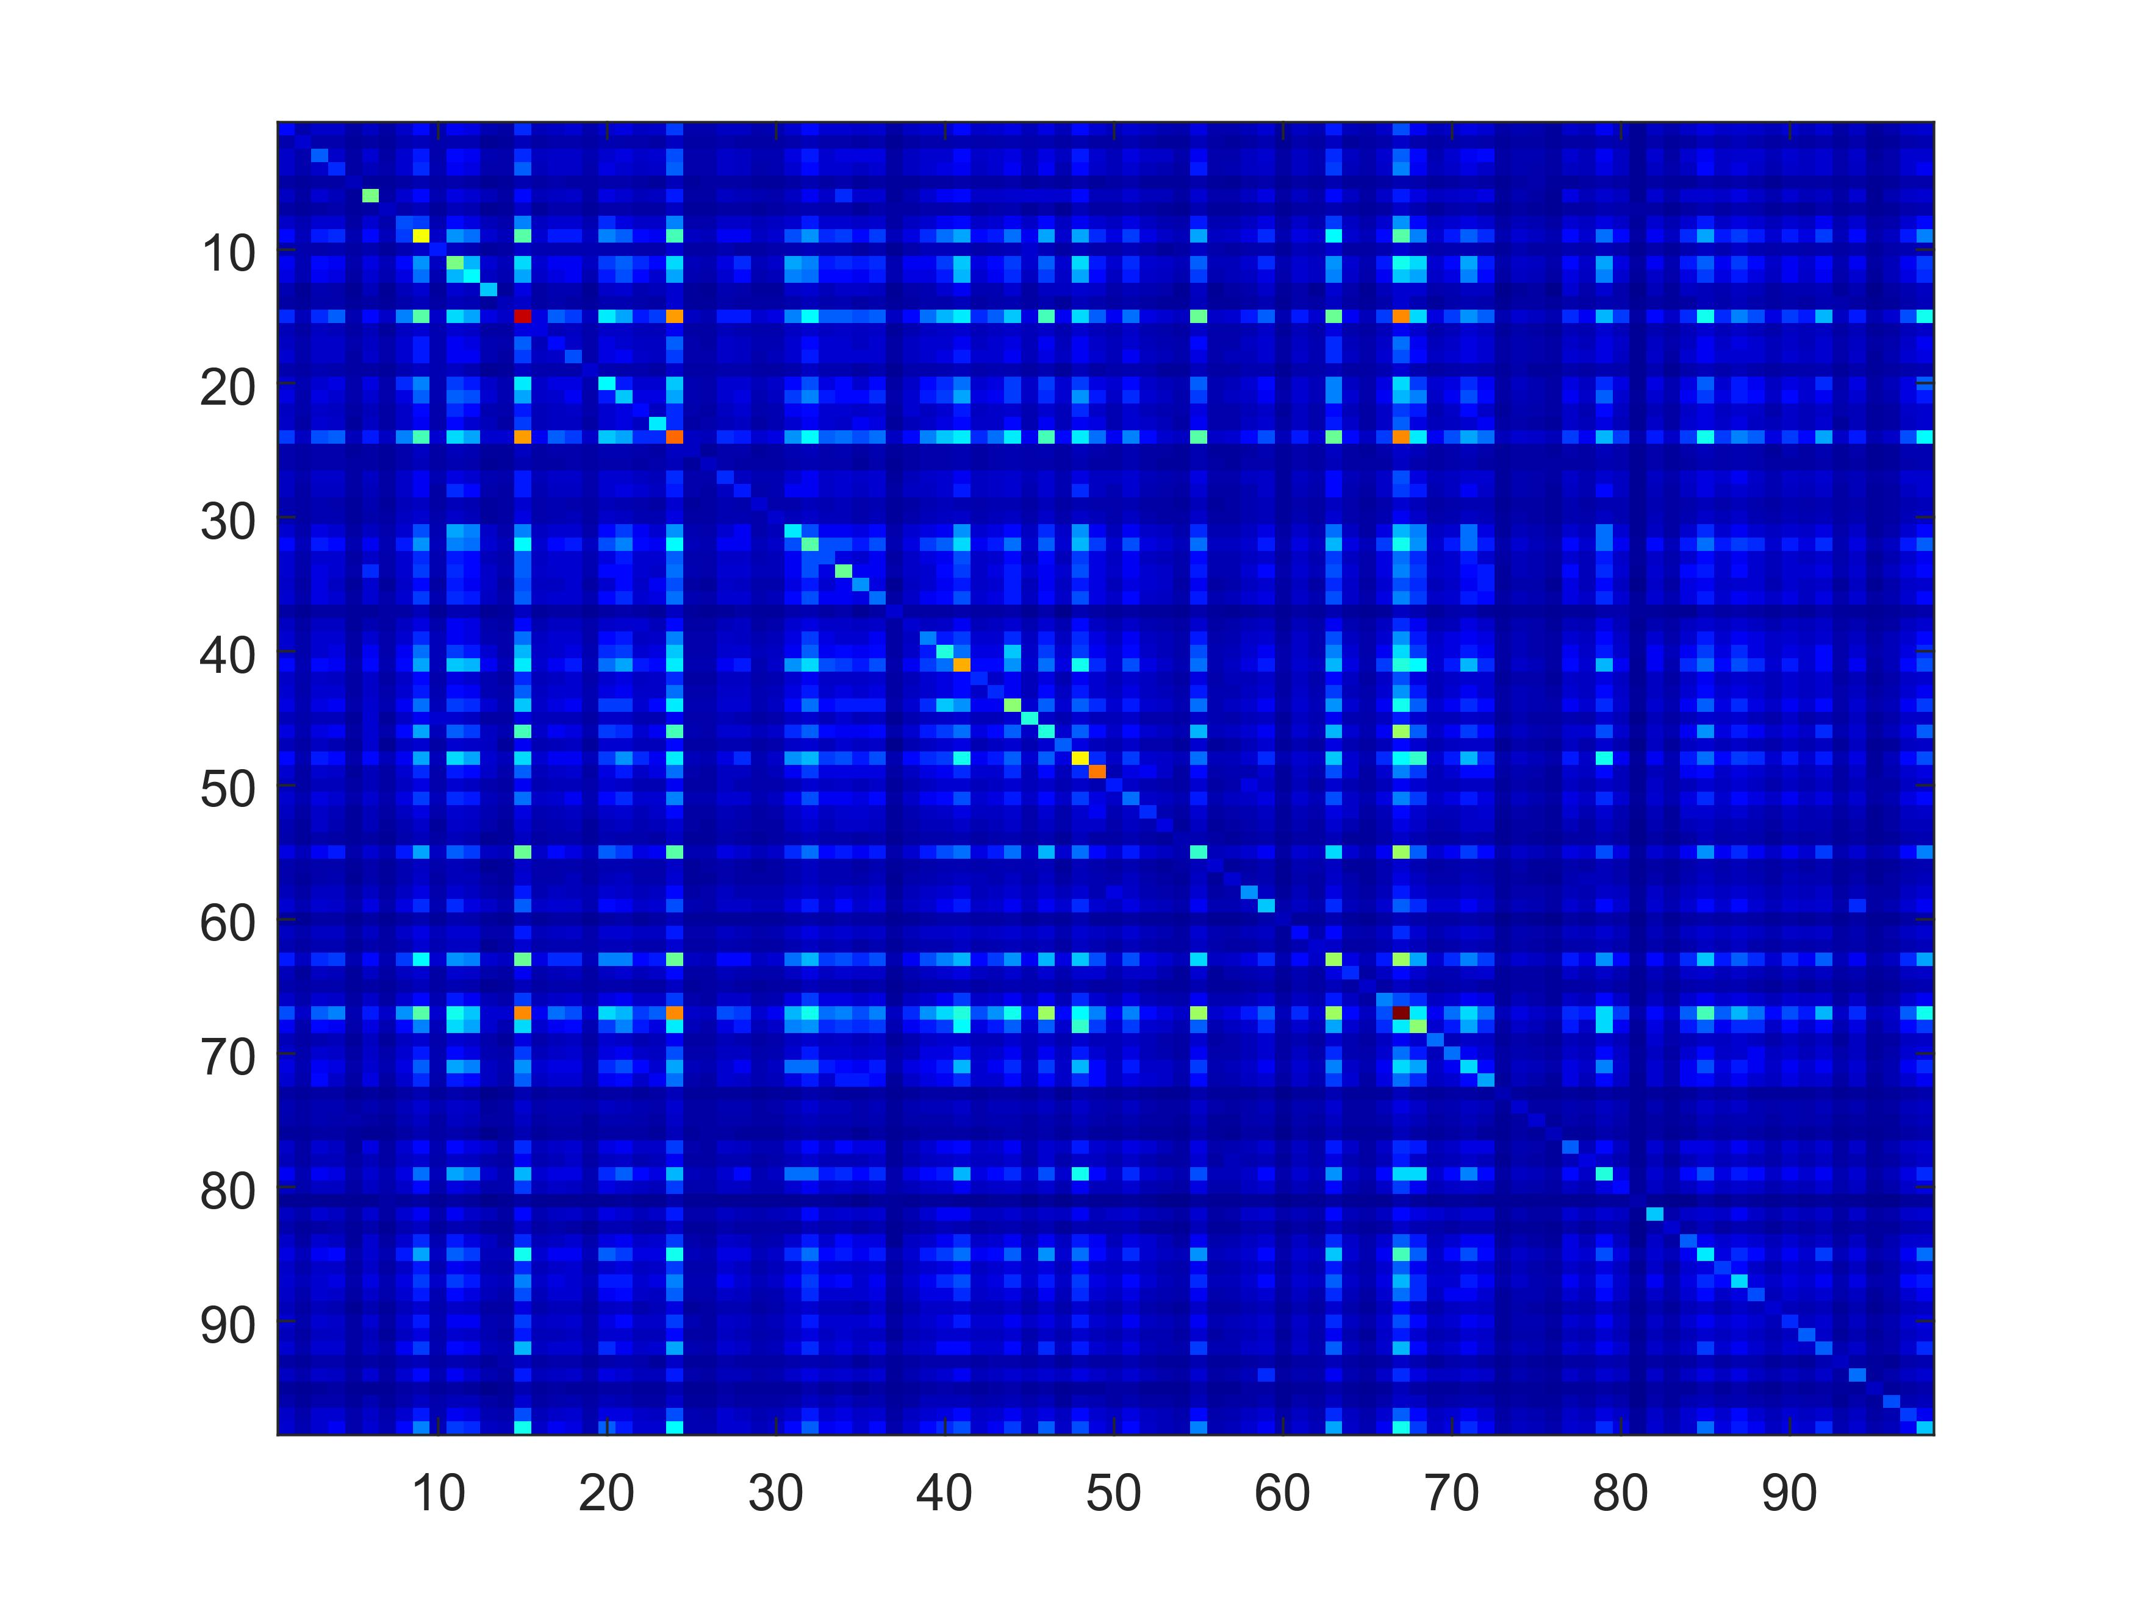
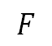
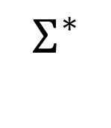
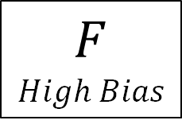
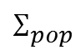
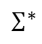
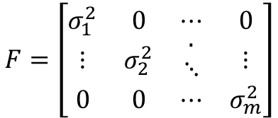
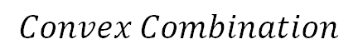
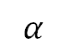
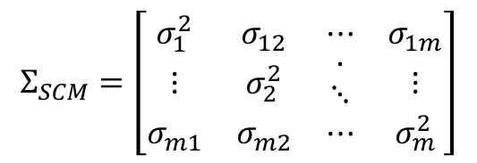
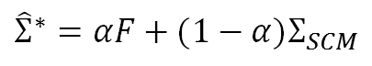
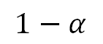
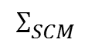
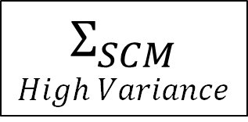
Linear Shrinkage
$$Σ_{SCM}$$
$$High Variance$$
$$Σ^{∗}$$
$$F$$
$$High Bias$$
$$Convex Combination$$
$$Σ_{SCM}=\left[\begin{matrix}σ_{1}^{2} & σ_{12} & ⋯ & σ_{1m} \\ ⋮ & σ_{2}^{2} & \begin{aligned}. \\ ⋱\end{aligned} & ⋮ \\ σ_{m1} & σ_{m2} & ⋯ & σ_{m}^{2}\end{matrix}\right]$$
${\hat{Σ}}^{∗}=αF+(1−α)Σ_{SCM}$
$$F=\left[\begin{matrix}σ_{1}^{2} & 0 & ⋯ & 0 \\ ⋮ & σ_{2}^{2} & \begin{aligned}. \\ ⋱\end{aligned} & ⋮ \\ 0 & 0 & ⋯ & σ_{m}^{2}\end{matrix}\right]$$
$$Σ_{pop}$$
$$1−α$$
$$α$$
$$Σ_{SCM }$$
$$Σ^{∗}$$
$$F$$

Slide 13

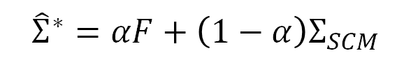

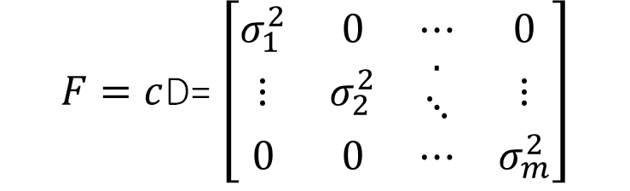
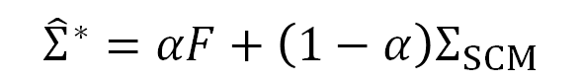
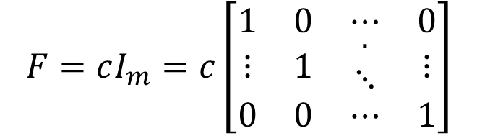
Linear Shrinkage Estimator-1: Fixed Variance-Zero Covariance [FV-ZC]
$${minimize E[\left\|{\hat{Σ}}^{∗}−Σ_{pop}\right\|}^{2}]$$
subject to:
${\hat{Σ}}^{∗}=α(cI_{m})+\left(1−α\right)Σ_{SCM}$
c$=\frac{trace(Σ_{SCM}\text{)} }{trace(I_{m})}$
${\hat{Σ}}^{∗}=αI_{m}\frac{trace(Σ_{SCM}\text{)} }{trace(I_{m})}+\left(1−α\right)Σ_{SCM}$
$${\hat{Σ}}^{∗}=αF+\left(1−α\right)Σ_{SCM}$$
$$F=cI_{m}=c\left[\begin{matrix}1 & 0 & ⋯ & 0 \\ ⋮ & 1 & \begin{aligned}. \\ ⋱\end{aligned} & ⋮ \\ 0 & 0 & ⋯ & 1\end{matrix}\right]$$
Linear Shrinkage Estimator-2:
Sample Variance-Zero Covariance [SV-ZC]
$${minimize E[\left\|{\hat{Σ}}^{∗}−Σ_{pop}\right\|}^{2}]$$
subject to:
${\hat{Σ}}^{∗}=α(cD)+\left(1−α\right)Σ_{SCM}$
c$=\frac{trace(\hat{Σ}\text{)} }{trace(D)}$
$${\hat{Σ}}^{∗}=αD\frac{trace(Σ_{SCM}\text{)} }{trace(D)}+\left(1−α\right)Σ_{SCM}$$
$${\hat{Σ}}^{∗}=αF+\left(1−α\right)Σ_{SCM}$$
$F=c$D= $\left[\begin{matrix}σ_{1}^{2} & 0 & ⋯ & 0 \\ ⋮ & σ_{2}^{2} & \begin{aligned}. \\ ⋱\end{aligned} & ⋮ \\ 0 & 0 & ⋯ & σ_{m}^{2}\end{matrix}\right]$

Slide 14
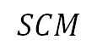
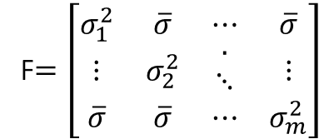

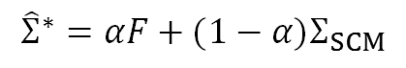
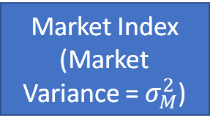

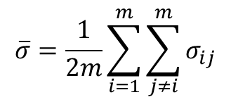
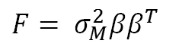
Linear Shrinkage Estimator-3:
Sample Variance-Mean Covariance [SV-FC]
$${\hat{Σ}}^{∗}=αF+(1−α)Σ_{SCM}$$
${minimize E[\left\|{\hat{Σ}}^{∗}−Σ_{pop}\right\|}^{2}]$
$=E\left[{\left\|\left(1−α\right){\hat{Σ}}_{scm}+αF−Σ_{pop}\right\|}^{2}\right]$
subject to :
${\hat{Σ}}^{∗}=αF+\left(1−α\right)Σ_{SCM}$
$α^{∗}= \frac{Σ_{i=1}^{N}Σ_{i=1}^{N}var(s_{ij}−cov(f_{ij},s_{ij}\text{)}}{Σ_{i=1}^{N}Σ_{i=1}^{N}var\left(f_{ij}−s_{ij}\right)+{\left(φ_{ij}−σ_{ij}\right)}^{2} }$
F$=\left[\begin{matrix}σ_{1}^{2} & \overline{σ} & ⋯ & \overline{σ} \\ ⋮ & σ_{2}^{2} & \begin{aligned}. \\ ⋱\end{aligned} & ⋮ \\ \overline{σ} & \overline{σ} & ⋯ & σ_{m}^{2}\end{matrix}\right]$
$$\overline{σ}=\frac{1}{2m}\sum_{i=1}^{m}{\sum_{j≠i}^{m}{σ_{ij}}}$$
Linear Shrinkage Estimator-4:
Sharpe’s Single Indexed model-based Variance and Covariance[SIM]
Slopes $β_{i}$
Stock-1
Stock-2
Stock-3
Stock-1
Stock-2
Stock-3
Stock-1
Stock-2
Stock-3
Market Index
(Market Variance = $σ_{M}^{2}$)
$$SCM$$
$F= σ_{M}^{2}ββ^{T}$

Slide 15
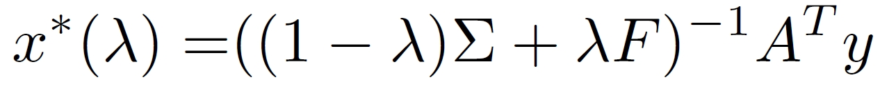
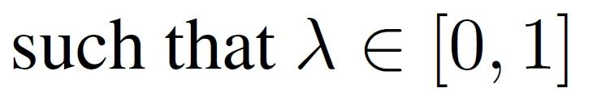
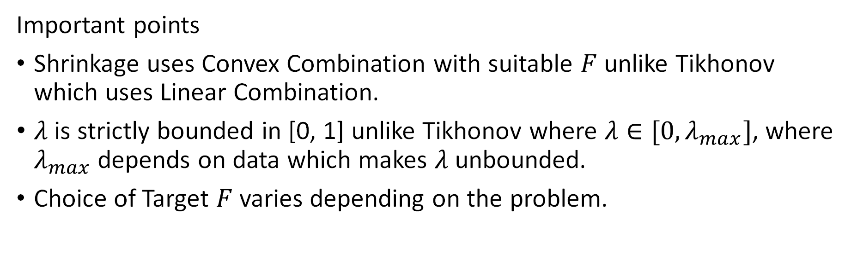
Proposed Method 1: Reformulate Tikhonov
Important points
Shrinkage uses Convex Combination with suitable $F$ unlike Tikhonov which uses Linear Combination.
$λ$ is strictly bounded in [0, 1] unlike Tikhonov where $λ∈[0, λ_{max}]$, where $λ_{max}$ depends on data which makes $λ$ unbounded.
Choice of Target $F$ varies depending on the problem.

Slide 16
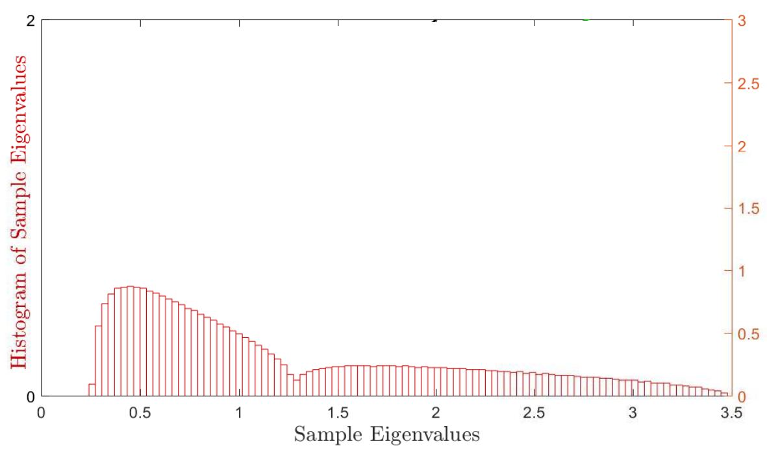
Spectral interpretation of Shrinkage
More advanced Non-linear shrinkage can also be used
Figure 1, Ledoit, Olivier, and Michael Wolf. "The power of (non-) linear shrinking: a review and guide to covariance matrix estimation." Journal of Financial Econometrics (2019).

Slide 17
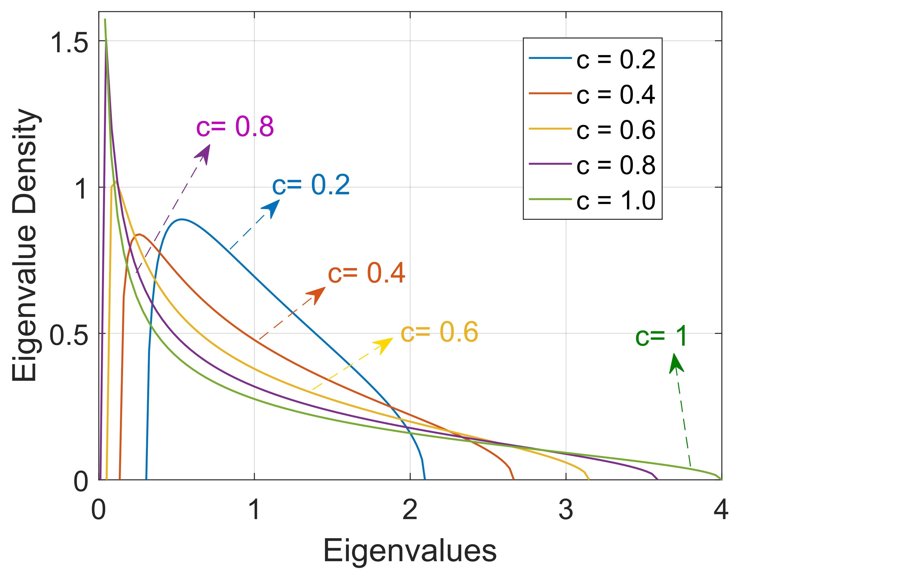
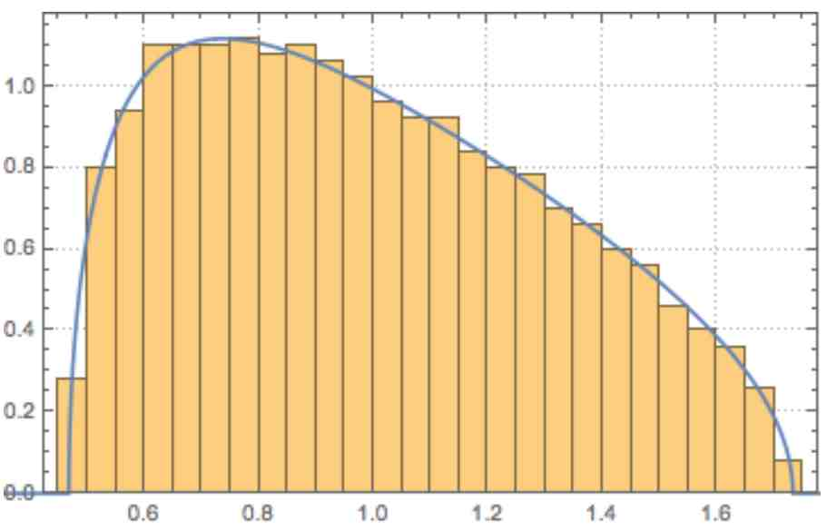
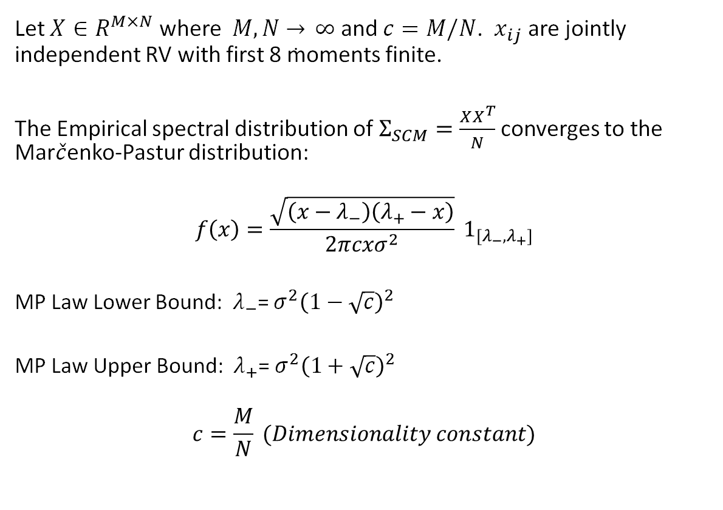
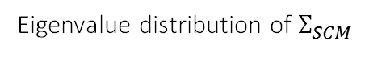
Marchenko-Pastur Law (MP Law)
Let $X∈R^{M×N}$ where $M, N \overset{→}{.} ∞$ and $c=M/N$. $x_{ij}$ are jointly independent RV with first 8 moments finite.
The Empirical spectral distribution of $Σ_{SCM}=\frac{XX^{T}}{N}$ converges to the Mar$\check{c}$enko-Pastur distribution:
$$f\left(x\right)=\frac{\sqrt{\left(x−λ_{−}\right)\left(λ_{+}−x\right)}}{2πcxσ^{2}} 1_{[λ_{−},λ_{+}]}$$
MP Law Lower Bound: $λ_{−}$= $σ^{2}{\left(1−\sqrt{c}\right)}^{2}$
MP Law Upper Bound: $λ_{+}$= $σ^{2}{\left(1+\sqrt{c}\right)}^{2}$
$$c=\frac{M}{N} (Dimensionality constant)$$
Eigenvalue distribution of $Σ_{SCM}$

Slide 18



Proposed method-2: Covariance Cleaning Using MP Law
No tuning parameter required!
Obtain the sample correlation matrix as $C=D^{−\frac{1}{2}}A^{T}A{ D}^{−\frac{1}{2}}$
Represent $C$ in terms of Eigenvalues ($λ_{i}$) and Eigenvectors ($v_{i}$)
$$C=VΛV^{T}$$
Sample eigenvalues of $C$ are $e_{i}$= $diag$($Λ$), $i$= 1, 2, . . ., m
Find all eigenvalues under MP law bound and replace them with a constant value such that $trace(Λ) = trace(Λ^{clean})$
$e_{i}=e_{mean}$ if $e_{i}<$ $e_{+}$
Reconstruct the cleaned correlation matrix using cleaned eigenvalues:
$$C_{clip}=V{(Λ}^{clean})V^{T}$$
Reconstruct the cleaned covariance matrix $Σ_{MP}=D^{\frac{1}{2}}{ C}_{clip} D^{\frac{1}{2}}$
Noisy Eigenvalues
Spike Eigenvalues

Slide 19
Presentation Outline
Problem Statement and Motivation
Problem Formulation
Establishing Connection to Random Matrix Theory (RMT)
Proposed methods based on RMT
Marchenko-Pastur law (MP law) based method
Shrinkage Transformations
Results and Interpretations
Summary

Slide 20


Inverse Scattering Imaging
Image the refractive index profile of an indoor environment using radio waves
Image and track changes in the environment without any device on the object to be tracked
Design a system that is practically feasible
Should work with limited measurements (Ill-posed)
Permittivity Profile

Slide 21



Experimental Setup
0.5 meters
Scatterer
$$ε_{r}=1.1$$
In ill-posed problem $y=Ax$
$y∈R^{190×1}$ is measurement vector
$x∈R^{2500×1}$ is to be estimated (refractive index in pixels of image)
$A∈R^{190×2500}$ is model matrix

Slide 22

Performance Comparison
Methods | Analytical solution | Tuning for $λ$ | Average SSIM
Traditional Tikhonov Regularization | $$x_{Tikh}^{∗}\left(λ\right)= {\left(A^{T}A+λ T\right)}^{−1} A^{T}y$$ | Need to tune $λ$ in range $[0, λ_{max}]$ | 0.68
Proposed modified Tikhonov using shrinkage transformation | $$x_{ST}^{∗}\left(λ\right)= {\left(\left(1−λ\right)A^{T}A+λ F\right)}^{−1} A^{T}y$$ | Need to tune $λ$ in range $[0, 1]$ | 0.88
Proposed method using MP law | $$x_{MP}^{∗}= {\left(Σ_{MP}\right)}^{−1} A^{T}y$$ | No tuning required | 0.87
Proposed PCA based result from mini-project | (Refer to mini-project report for details) | No tuning required | 0.74
Proposed SPCA based result from mini-project | (Refer to mini-project report for details) | No tuning required | 0.77

Slide 23

Traditional Tikhonov
Reconstructions using Traditional Tikhonov using 40 values of $λ$ uniformly sampled from $[0, λ_{max}]$

Slide 24



L-Curve for Traditional Tikhonov
Sharpest Knee ($λ_{18}$) gives poor reconstruction
Reconstruction not optimal for any knee-points

Slide 25

Modified Tikhonov using Shrinkage
Reconstructions using Shrinkage using 40 values of $λ$ uniformly sampled from $[0, 1]$

Slide 26

Comparison
Traditional Tikhonov
Shrinkage Transformation

Slide 27

Comparison of all methods
Performance: Proposed Shrinkage solution > MP law based solution > PCA > SCPA > Traditional Tikhonov

Slide 28

More Intricate Profile

Slide 29
Presentation Outline
Problem Statement and Motivation
Problem Formulation
Establishing Connection to Random Matrix Theory (RMT)
Proposed methods based on RMT
Marcenko-Pastur law (MP law) based method
Shrinkage Transformations
Results and Interpretations
Summary

Slide 30


Summary
Proposed methods to solve ill-posed problems using RMT
Clean Covariance Matrix for better results
Proposed methods ease tuning of $λ$ OR remove need for tuning completely
Shrinkage solution provide better L-curve than traditional Tikhonov
Methods | Analytical solution | Tuning for $λ$ | Average SSIM
Traditional Tikhonov Regularization | $$x_{Tikh}^{∗}\left(λ\right)= {\left(A^{T}A+λ T\right)}^{−1} A^{T}y$$ | Need to tune $λ$ in range $[0, λ_{max}]$ | 0.68
Proposed modified Tikhonov using shrinkage transformation | $$x_{ST}^{∗}\left(λ\right)= {\left(\left(1−λ\right)A^{T}A+λ F\right)}^{−1} A^{T}y$$ | Need to tune $λ$ in range $[0, 1]$ | 0.88
Proposed method using MP law | $$x_{MP}^{∗}= {\left(Σ_{MP}\right)}^{−1} A^{T}y$$ | No tuning required | 0.87
Proposed PCA based result from mini-project | (Refer to mini-project report for details) | No tuning required | 0.74
Proposed SPCA based result from mini-project | (Refer to mini-project report for details) | No tuning required | 0.77
Future Work
Explore Beyond differentiable regularizers (like TV or LASSO)
Find mathematical reasoning for improvement in L-Curve

Slide 31
Future Work
Explore Beyond differentiable regularizers (like TV or LASSO)
Find mathematical reasoning for improvement in L-Curve

Slide 32

Contributions

